Slide 1
System Application and Program (SAP)

Slide 2
What is SAP?
SAP stands for “Systems Application Program.” The SAP acronym is a widely used shorthand term for software, computer programs, and applications that all fall under the umbrella of SAP systems.
Some examples of applications that fall under the SAP acronym are accounting software, inventory management software, database management software and web application software. To be more specific, SAP is a business-to-business (B2B) application development platform which allows organizations to manage and optimize their business processes in order to increase productivity and profitability. By providing organizations with real-time access to critical information from multiple sources, such as financial data, inventory records and customer profiles, SAP systems enable them to effectively manage their operations. By streamlining business processes and reducing operational costs, SAP systems can help companies achieve greater growth and profitability.

Slide 3
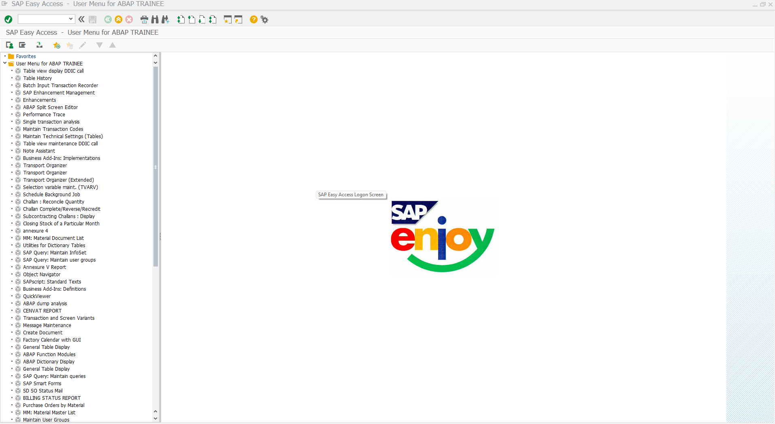
SAP Log On Page

Slide 4
System Landscape Directory
The SAP system landscape is a logical group of servers or a layout arranging different servers like development, quality assurance, and production server.
The SAP landscape differs from SAP architecture as the organization can modify or update SAP architecture based on their requirements, but they cannot change the SAP landscape. The SAP system landscape is an outcome of various levels of SAP implementation.
It is also known as the architecture of servers. These servers are as follows:
Development Server
Quality Server
Production Server

Slide 5
Development Server
This server is responsible for all the development-based activities where organizations develop new customizations based on the requirements. It is also known as a sandbox client.
It helps business companies undergo trial and error for exploring their business ideas without any real-time consequences. Using the development server, business consultants or the management team do new customization and write new programs per the requirements.
It includes three clients
Sandbox: A sandbox client is a part of the SAP landscape development section. It is a playground for business management teams to test their system design before real-time outcomes.
Development-testing: It is responsible for undergoing unit testing, and often business companies can use this client for the integration testing phase.
Customizing clients: Customizing clients defines the technical structure of the SAP landscape system. It is the server of the SAP landscape where business management teams perform tests on the newly developed customizations.

Slide 6
Quality Server:In this phase, the team members test the customization or programs. It has two separate sections, namely the testing server and the training server, and allows corporation teams to accomplish all cross-functional testing in the box. SAP landscape has 300 Quality Assurance Servers.
Production Server:It is also known as the golden client, another SAP landscape client where data reaches after all the integrations, customizations, and filtration. The production server is the main server that maintains documents of all the live data of the business companies once the project goes live.

Slide 7
SAP 3 Tier Architecture: Different SAP Layers
The SAP System Architecture includes Presentation, Application, and Database layers. Each of these programmes operates on its own. In contrast, MiniSAP has all the components in one machine. We may distribute the whole system across diverse machines or it may also be on one machine like ours. The database and the application server can be on the same machine if we want to get an idea of the SAP system architecture in greater depth. In addition to these application servers, other applications are run on separate machines. To better grasp the SAP architecture, let’s look at these three elements in more detail.
The SAP System Architecture consists of the Presentation, Application, and Database layers:
Presentation Layer
Application Layer
Database Layer

Slide 8
Presentation Layer
The presentation layer is responsible for the user experience and for making sure that the SAP system is responsive and easy to interact with.
The presentation layer does not have any knowledge of the underlying data stored in the data layer.
The data layer holds all the data that is being stored in the SAP system. The data layer is the realm where all the business rules and processes take place.
The data layer exists between the presentation layer and the application server.
When you connect to the application server and start to do work, the application server, which is the realm where all the logic happens, knows nothing about the data layer.

Slide 9
Application Layer
This layer of the architecture is responsible for receiving and parsing data before it can be used by any part of the organization.
This layer is also responsible for providing data within the correct format for each application.
The last responsibility of the application layer is to ensure that the data is secure before it is sent to the next layer.
This layer of architecture is a critical component to the success of your digital transformation. The work process must be carried out by a user who is registered in the system. For this reason, we define the work process as a user of the system. The work process will register itself in the database, and when it is required to create a new record in the system, this is done by the work process. The work process can be created by the system administrator through the SAP system. In the case of the SAP system, this can be done by setting the role of the user to a specific value. What happens when you do this is that the SAP system will create a new user in the database system. This user will register itself in the database, and when the system needs to create a new record, the user can do this. The user will create the work process, and when the system requires the work process to create a new record, the user will create the process.

Slide 10
Database Layer
The system architecture is what defines how your SAP system is set up.
If you were setting up a new company, you would choose a system architecture based on the type of business you want to start.
For example, a manufacturer of motorcycles and scooters would be best served by a system architecture that focuses on production and inventory. A hotel would do best with a system architecture that focuses on customer relations. Once you have chosen the setting for your new company, you need to choose the SAP system architecture. The application and database layers receive information about actions performed on the presentation layer and then query the results. As a result, you can see the results of processing on the presentation layer.

Slide 11
Initial screen of ABAP dictionary
At the initial screen, you can put any tables or structures to view, edit or even create a new one. Transaction code SE11 is normally used a ABAP programmer.
1. Database table: – It helps in create and maintain the tables, table should begin with letter Y or Z and length up to 16 characters.
2. View : – It act as virtual table and helps in retrieve the data.
3. Data type: – It helps in creating the user defined data elements, structure and tables.
4. Type group: – It creates the data group types in dictionary
5. Domain: – Domain specifies the technical characters of a field such as data type field and length.
6. Search help: – It defines the search help (F4) for the fields of database table and helps in providing the values for a user search queries
7. Lock object : – It is used to synchronize the same data by one user or multiple users. SAP provides three types of lock objects- Read lock, write lock, enhanced lock.

Slide 12
Initial Screen Of ABAP Dictionary
ABAP Dictionary
Database Table
View
Data Type
Type Group
Domain
Search Help
Lock Object

Slide 13
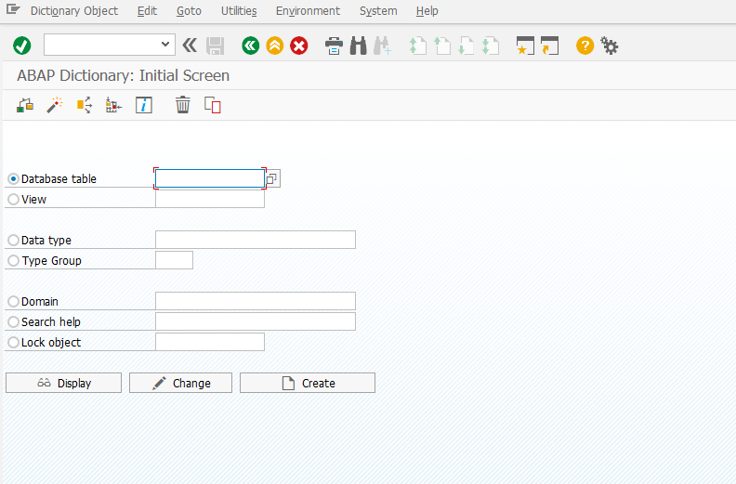
Initial Screen of ABAP Dictionary

Slide 14
Database Table
In ABAP Dictionary, the term "database table" (or table for short) is the database-independent definition of a database table. In Open SQL, only those database tables can be accessed that are defined in ABAP Dictionary.
The name of a database table in ABAP Dictionary can have a maximum of 16 characters, can consist of letters, numbers, and underscores, must start with a letter can be prefixed by a namespace prefix (/.../) of a prefix namespace. It is in the namespace of the data types in ABAP Dictionary.
Tables can be defined independently of the database in the ABAP Dictionary. The fields of the table are defined with their (database-independent) data types and lengths.
When the table is activated, the system creates a physical table definition in the database for the table definition stored in the ABAP Dictionary.

Slide 15
Database Table
Database Table
Delivery and Maintenance
Fields
Input Help/Check
Currency/ Quantity Fields

Slide 16
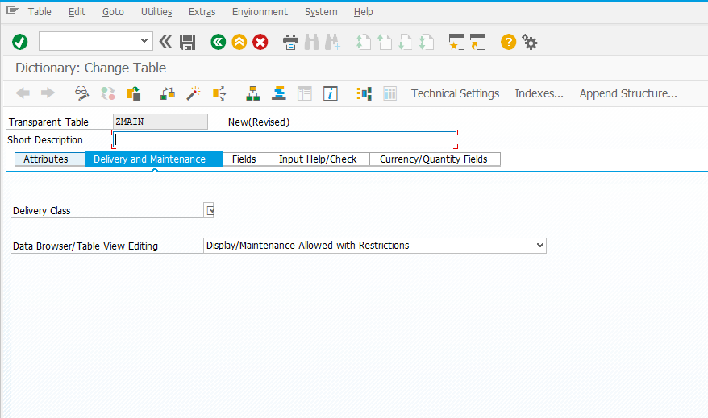
View of Database Table

Slide 17
Delivery and Maintenance
The “delivery class” controls the transport of table data for installation, upgrade, client copy and when transporting between customer systems. The delivery class is also used in the extended table maintenance.
There are the following development classes:
A: Application table (master and transaction data).its consist of master data and transactional data
Master data: It is created frequently but change rarely
Transactional data: The Data is created Frequently but changes frequently
G: Customer table, SAP may insert new data records but may not overwrite or delete existing ones. The customer namespace must be defined in table TRESC. To define the customer namespace use report RDDKOR54. You can start it directly from the table maintenance by choosing Customer namespace definition on the Attributes tab.
E: System table with its own namespace for customer entries. The customer namespace must be defined in table TRESC. To define the customer namespace use report RDDKOR54. You can start it directly from the table maintenance by choosing Customer namespace definition on the Attributes tab.
D: Short Description
Data Browser/Table View Maintenance: (SAP Library - BC - ABAP Dictionary) we can use the flag for database views, projection views, maintenance views, maintenance view variants, and tables in the Dictionary maintenance (SE11).

Slide 18
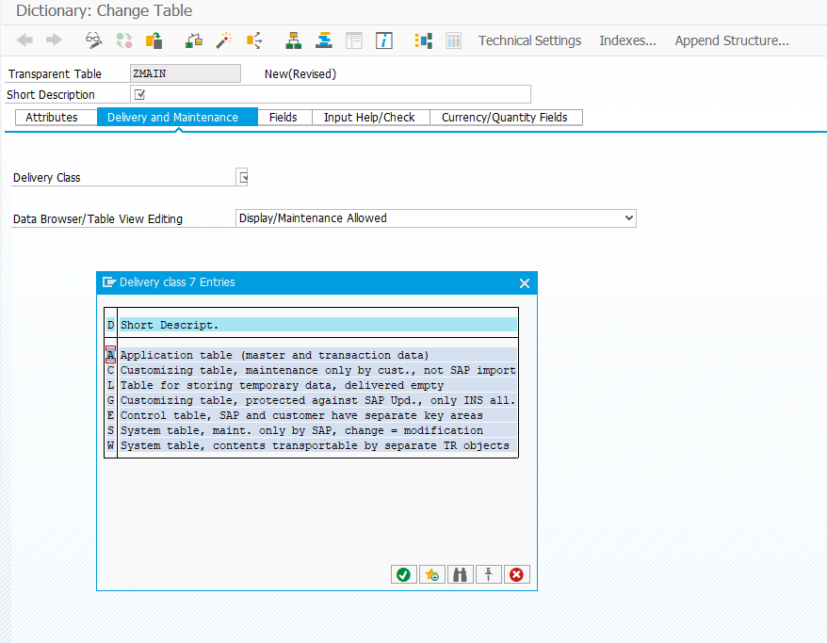
View of Delivery and Maintenance

Slide 19
Fields
Field:The field name can have a maximum of 16 places and can contain letters, digits and underscores. The field name must begin with a letter.
Key:Determines whether the field belongs to the table key.
Initial Value:Set this indicator if a field must have an initial value.
Data element: Defines an elementary data type or a reference type and describes, alongside the technical type attributes, the semantic meaning of an object defined with reference to the data element.
Data Type:Data type of the field in the ABAP Dictionary.
Length:Determines the number of valid places in the field.
Decimal Places:The number of places after the decimal point, specifying numeric data types.
Short Description:Short text describing the meaning of the field.

Slide 20
Input help/Check
Use
The main input help available from the ABAP Dictionary is in the form of search helps. Search helps are independent Repository objects that you create using the ABAP Dictionary. They are used to present input help for screen fields. You can link search helps to table fields and data elements. As well as search helps, you can still, in exceptional cases, use check tables, fixed values, or static input help.
Input Help Methods
Search helps
There are two kinds of search helps: elementary and collective. An elementary search help represents a search path. It defines the location of the data for the hit list, how values are exchanged between the screen and the selection method, and the user dialog that occurs when the user chooses input help. A collective search help consists of two or more elementary search helps. A collective search help combines all the search paths that are meaningful for a field. The collective search help is the interface between the screen and the various elementary search helps.
Check tables
The ABAP Dictionary allows you to define relationships between tables using foreign keys. A dependent table is called a foreign key table, and the referenced table is called the check table. Each key field of the check table corresponds to a field in the foreign key table. These fields are called foreign key fields. One of the foreign key fields is designated as the check field for checking the validity of values. The key fields of the check table can serve as input help for the check field.
Fixed values
You can restrict the values that a domain in the ABAP Dictionary may take by assigning fixed values to it. The fixed values can be used as input help for the fields that are defined using that domain. However, the value table of a domain is not used for input help. It is only used as a default value for the check tables of the fields that refer to the domain.
Static input help
Fields with the types DATS and TIMS have their own predefined calendar and clock help that can be used as input help.

Slide 21
Currency and Quantity Field
Use
Currency amount fields and quantity fields are numeric fields which each have a currency or unit field assigned to them.
The correct interpretation of the values in these fields depends on its currency or unit of measure. Therefore, you can
decide whether you want their corresponding
currency/unit of measure to be displayed before or after the field, or not at all. To do this, follow the procedure below:
Select the field.
Choose one of the options from the window on the lower left ( before, no currency field/unit, or after).
Choose Apply

Slide 22
Fields
Fields
Field
Key
Initial Value
Data element
Data Type
Length
Decimal Places
Short Description

Slide 23
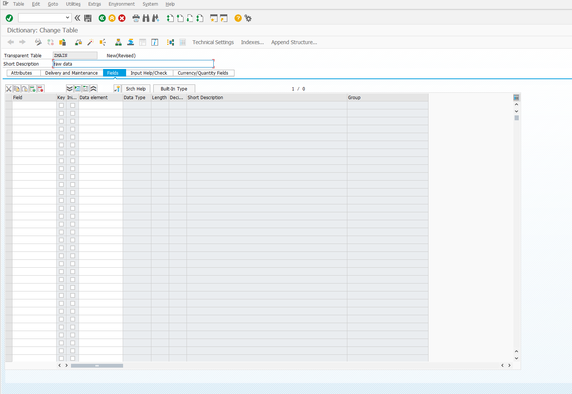
View of Fields

Slide 24
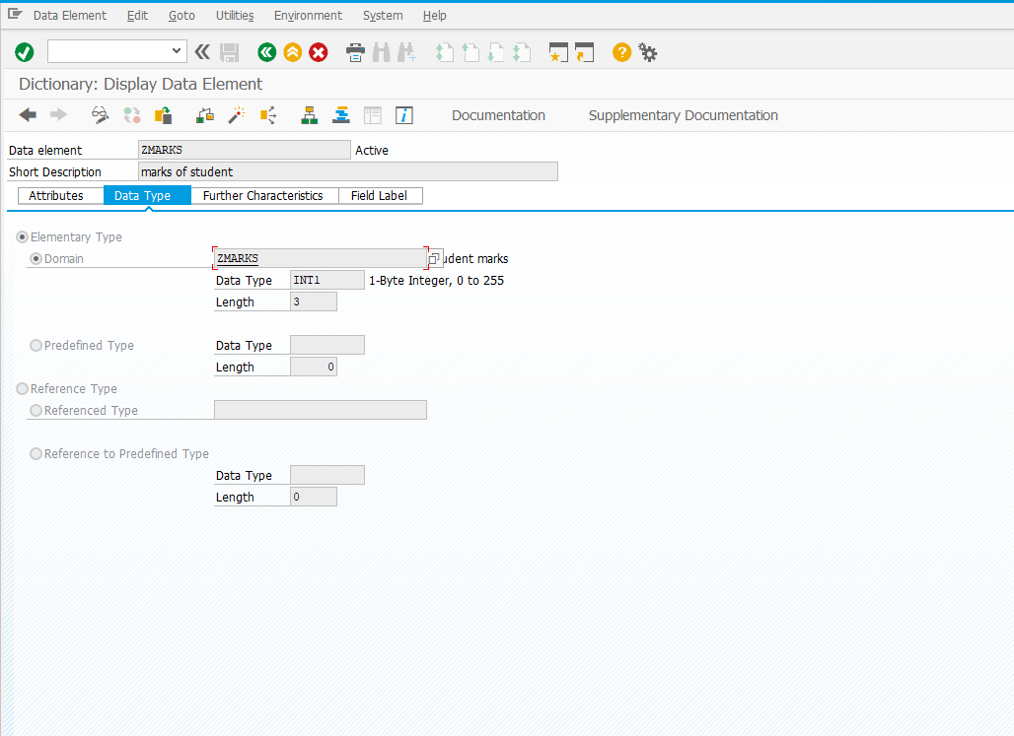
View of Domain

Slide 25
Technical Settings
Use
You use the technical settings of a table to define how the table is handled when it is created in the database. You can specify whether the table is buffered and whether changes to the table’s data records are logged.
Features
The most important parameters are:
● Data class:
The data class defines the physical area of the database (table space) in which the table must be created.
● Size category:
The size category defines the size of the extents created for the table.
When the table is created in the database, the system determines the required information about the memory area to be selected and the extent size from the technical settings.
● Buffering permission:
The buffering permission defines whether the table can be buffered.
● Buffering type:
If the table can be buffered, you must define a buffering type (full, generic, single-record). The buffering type defines how many table records are loaded into the buffer when a table entry is accessed.
● Logging:
This parameter defines whether the system logs changes to the table entries. If logging is switched on, the system records each change to a table record in a log table.
● Write access only with JAVA
Using the indicator "Write access with Java only" you can define that contents of the table may only be changed from within Java. If you implement changes (INSERT, UPDATE) to the table content through ABAP programs, there is no guarantee that this data can be read correctly from the Java side. If the data written by ABAP is ASCII data, it can be read from the Java side.
● The Convert to transparent table flag (transparent flag) is also displayed for pooled tables or for tables which were converted into transparent tables earlier on with this flag.

Slide 26
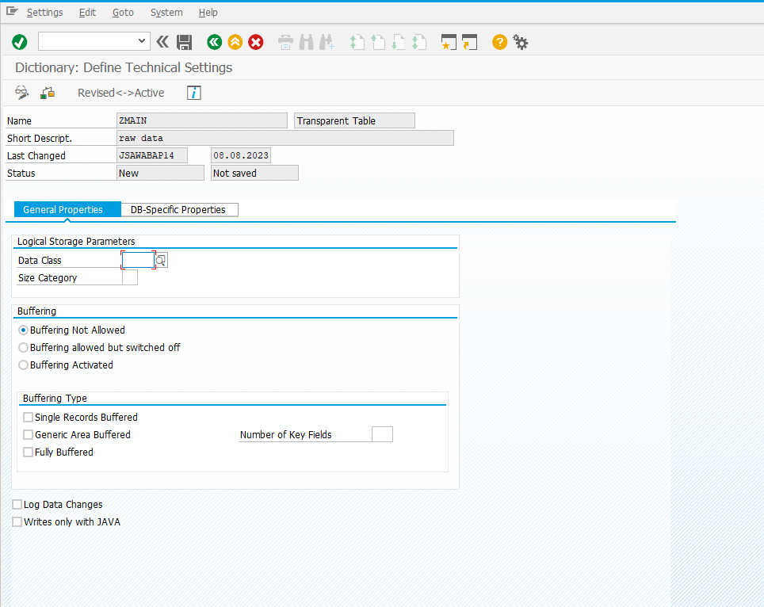
View of Technical Settings

Slide 27
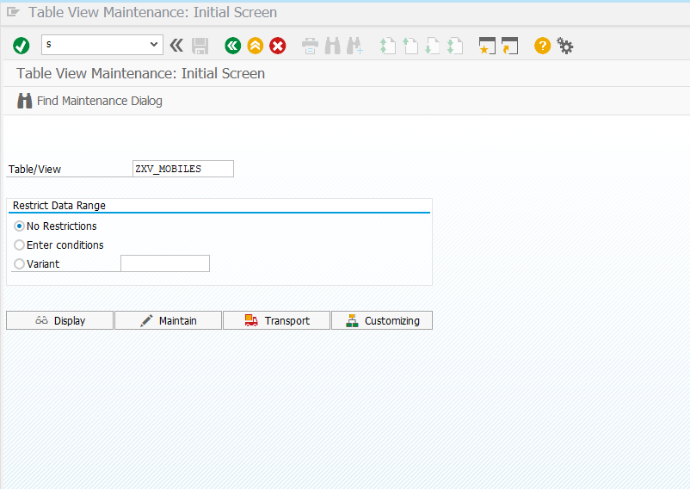
Table Maintenance Generator
Table maintenance generator is a tool which generate table maintenance program. Through table maintenance program we can maintain our custom table. That means through this tool we can edit, add and delete the entries from the custom table.

Slide 28
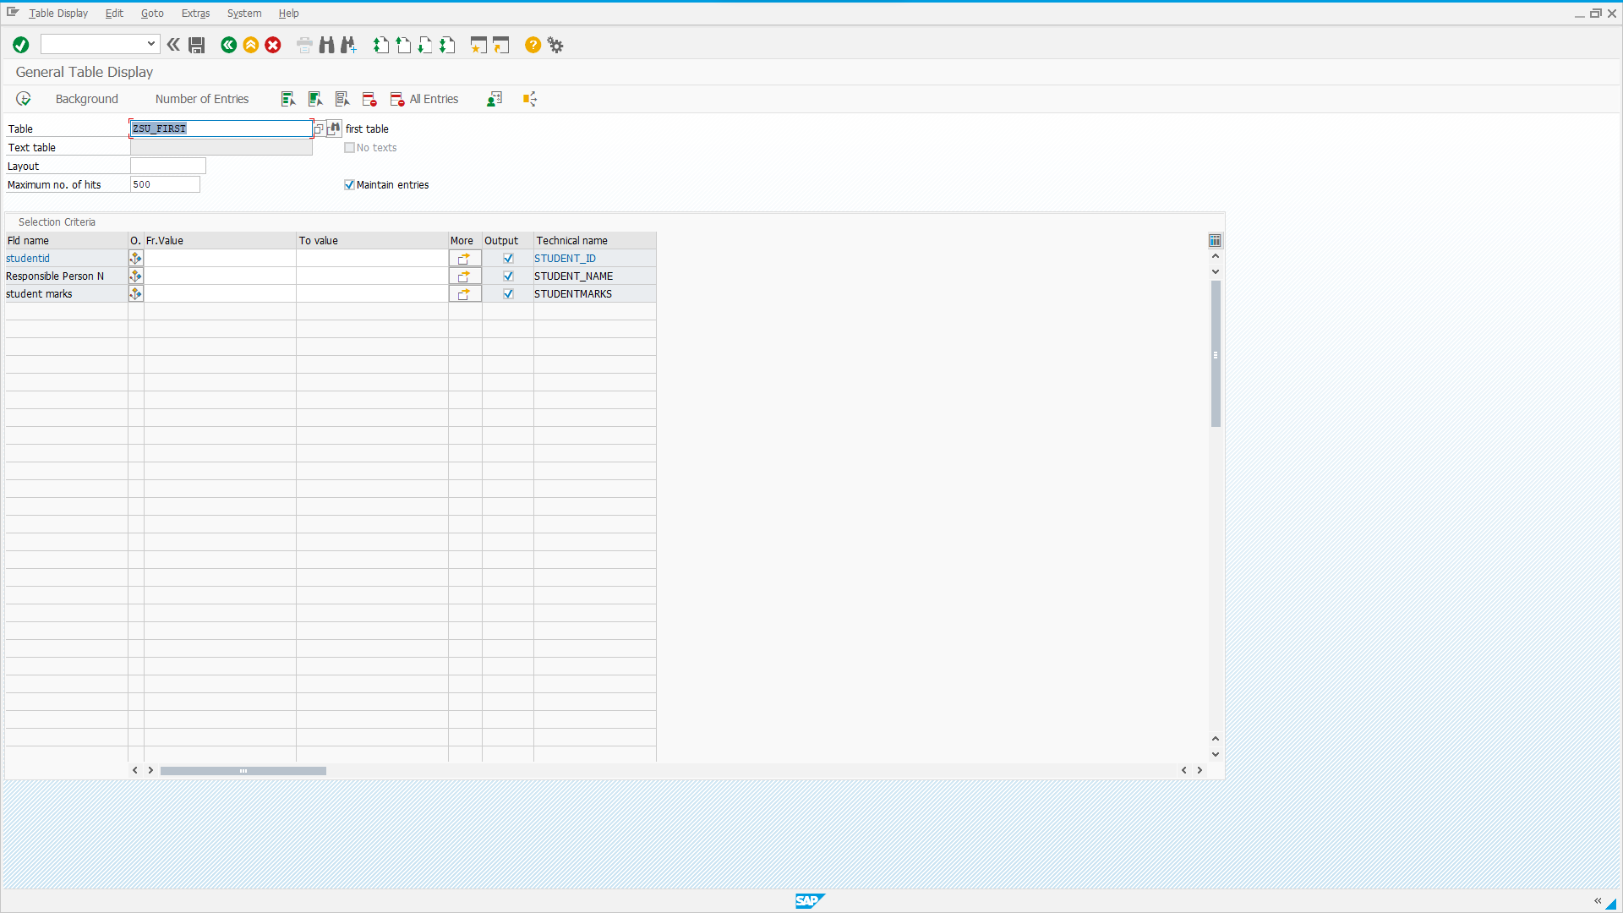
General Display of a table

Slide 29
Report
Report is the combination of given inputs to the selection-screen retrieving the data from data base based on the given input & display the output in a predefined format.
Report
Classical report
Interactive report
Alv report

Slide 30
Report Types
Types of Reports:-
Classical Reports :- It’s nothing but to display the entire information in a single list
Interactive Reports :It helps us to create easy-to-read lists. You can display an overview list first that contains general information and provide the user with the possibility of choosing detailed information that you display on further lists.
ALV Reports:ALV Report is one of the many ways of displaying SAP table data in a reporting manner. Acronym ALV stands for ABAP List Viewer. ALV Report in SAP ABAP are very commonly used in many standard and custom SAP transaction across different SAP modules.

Slide 31
Events in classical report
Initialization
At selection-screen
At selection-screen on
Start-of-selection
End-of-selection
Top-of-page
End-of-page

Slide 32
Event in classical Report
Initialization: - It’s an event which is triggered before displaying the selection-screen.
ADV: - it’s used to provide the default values to the selection-screen
At selection-screen: - It’s an event which is triggered after provide the input to the screen & before leaving the selectionscreen.
ADV: - This is used to validate the given input.
At selection-screen on: - It’s an event which is triggered at the selection-screen based on particular input field.
ADV: - This is used to validate the particular input field.
Start-of-selection: - It’s an event which is triggered after leaving the selection-screen & before display the output.
ADV: - This is used to fetch the data from data base & place into internal table.
End-of-selection: - It’s an event which is triggered after completion of the logic.
ADV: - This is used to display the output.
Top-of-page: - It’s an event which is triggered of the top of the each page.
ADV: - It’s used to display the header information.
End-of-page: - It’s an event which is triggered of the end of each page.
ADV: - It’s used to display the footer information.

Slide 33
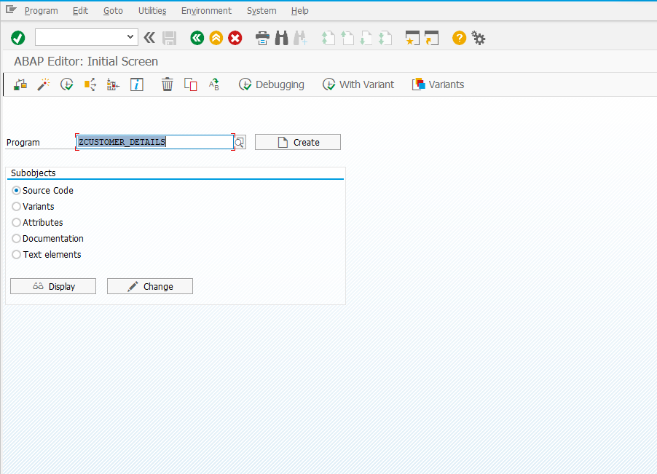
View of Report Initial Screen

Slide 34
Source Code for ALV Report.
REPORT ZCUSTOMER_DETAILS. TABLES:LFA1,LFB1,LFM1. """"""""""""""""""" Local Structure to display data in ALV ************************** TYPES:BEGIN OF TY_FINAL, LIFNR TYPE LIFNR, NAME1 TYPE LFA1-NAME1, ORT01 TYPE LFA1-ORT01, " City PSTLZ TYPE LFA1-PSTLZ, " Postal Code REGIO TYPE LFA1-REGIO , " Region\ STRAS TYPE LFA1-STRAS, " Address BUKRS TYPE LFB1-BUKRS, " Company code AKONT TYPE LFB1-AKONT, " Reco account ZWELS TYPE LFB1-ZWELS, " Payment method EKORG TYPE LFM1-EKORG, " Purch. Org. WEBRE TYPE LFM1-WEBRE, " GR-Based IV KALSK TYPE LFM1-KALSK, "Schema Grp Vndr END OF TY_FINAL.

Slide 35
""""""""""""""""""" Local Structure to display data in ALV ************************** """"""""""""" Declaration of Internal table *************************************** DATA:LT_FINAL TYPE TABLE OF TY_FINAL. DATA:LT_FCAT TYPE SLIS_T_FIELDCAT_ALV. """""""""""""""End of Declaration of Internal table """"""""""""""""""""""""""""""" """"""""""""" Declaration of Work Area *************************************** DATA:LW_FINAL TYPE TY_FINAL. DATA:LW_LAYOUT TYPE SLIS_LAYOUT_ALV. DATA:LW_FCAT TYPE SLIS_FIELDCAT_ALV. """""""""""""""End of Declaration of Work Area """"""""""""""""""""""""""""""" " *************** Selection Screen ******************************** SELECTION-SCREEN:BEGIN OF BLOCK B1 WITH FRAME TITLE TEXT-001. SELECT-OPTIONS:S_BUKRS FOR LFB1-BUKRS NO-EXTENSION NO INTERVALS MODIF ID M1, S_EKORG FOR LFM1-EKORG NO-EXTENSION NO INTERVALS MODIF ID M2, S_LIFNR FOR LFA1-LIFNR MODIF ID M3. SELECTION-SCREEN:END OF BLOCK B1.

Slide 36
""""""""""""""""""" Local Structure to display data in ALV ************************** """"""""""""" Declaration of Internal table *************************************** DATA:LT_FINAL TYPE TABLE OF TY_FINAL. DATA:LT_FCAT TYPE SLIS_T_FIELDCAT_ALV. """""""""""""""End of Declaration of Internal table """"""""""""""""""""""""""""""" """"""""""""" Declaration of Work Area *************************************** DATA:LW_FINAL TYPE TY_FINAL. DATA:LW_LAYOUT TYPE SLIS_LAYOUT_ALV. DATA:LW_FCAT TYPE SLIS_FIELDCAT_ALV. """""""""""""""End of Declaration of Work Area """"""""""""""""""""""""""""""" " *************** Selection Screen ******************************** SELECTION-SCREEN:BEGIN OF BLOCK B1 WITH FRAME TITLE TEXT-001. SELECT-OPTIONS:S_BUKRS FOR LFB1-BUKRS NO-EXTENSION NO INTERVALS MODIF ID M1, S_EKORG FOR LFM1-EKORG NO-EXTENSION NO INTERVALS MODIF ID M2, S_LIFNR FOR LFA1-LIFNR MODIF ID M3. SELECTION-SCREEN:END OF BLOCK B1.

Slide 37
SELECTION-SCREEN:BEGIN OF BLOCK B2 WITH FRAME TITLE TEXT-002 NO INTERVALS. PARAMETERS:P_RAD1 RADIOBUTTON GROUP RBG USER-COMMAND U1 DEFAULT 'X', P_RAD2 RADIOBUTTON GROUP RBG, P_RAD3 RADIOBUTTON GROUP RBG, P_RAD4 RADIOBUTTON GROUP RBG. SELECTION-SCREEN:END OF BLOCK B2. ***************** Selection Screen ************************ INITIALIZATION. AT SELECTION-SCREEN OUTPUT. PERFORM:SELECTION_OUTPUT. AT SELECTION-SCREEN. PERFORM:SELECTION_INPUT. START-OF-SELECTION. PERFORM:GET_DATA. PERFORM:BUILD_ALV. PERFORM:DISPLAY_ALV. END-OF-SELECTION.

Slide 38
FORM SELECTION_OUTPUT . IF P_RAD1 EQ ABAP_TRUE. LOOP AT SCREEN. IF SCREEN-GROUP1 EQ 'M1' OR SCREEN-GROUP1 EQ 'M2'. SCREEN-ACTIVE = 0. ENDIF. MODIFY SCREEN. ENDLOOP. ELSEIF P_RAD2 EQ ABAP_TRUE. LOOP AT SCREEN. IF SCREEN-GROUP1 EQ 'M2' OR SCREEN-GROUP1 EQ 'M3'. SCREEN-ACTIVE = 0. ENDIF. MODIFY SCREEN. ENDLOOP. ELSEIF P_RAD3 EQ ABAP_TRUE. LOOP AT SCREEN. IF SCREEN-GROUP1 EQ 'M1' OR SCREEN-GROUP1 EQ 'M3'. SCREEN-ACTIVE = 0. ENDIF. MODIFY SCREEN. ENDLOOP. ENDIF. ENDFORM.

Slide 39
FORM SELECTION_INPUT . IF P_RAD1 EQ ABAP_TRUE AND SY-UCOMM EQ 'ONLI'. IF S_LIFNR IS INITIAL. SET CURSOR FIELD 'S_LIFNR-LOW'. MESSAGE:'Please Enter Vendor code.' TYPE 'E'. ENDIF. ELSEIF P_RAD2 EQ ABAP_TRUE AND SY-UCOMM EQ 'ONLI'. IF S_BUKRS IS INITIAL. SET CURSOR FIELD 'S_BUKRS-LOW'. MESSAGE:'Please Enter Company code.' TYPE 'E'. ENDIF. ELSEIF P_RAD3 EQ ABAP_TRUE AND SY-UCOMM EQ 'ONLI'. IF S_EKORG IS INITIAL. SET CURSOR FIELD 'S_EKORG-LOW'. MESSAGE:'Please Enter Purch.Orginazation.' TYPE 'E'. ENDIF. ELSEIF P_RAD4 EQ ABAP_TRUE AND SY-UCOMM EQ 'ONLI'. IF S_EKORG IS INITIAL AND S_LIFNR IS INITIAL AND S_BUKRS IS INITIAL. MESSAGE:'Please Enter Either Company Code , Vendor Code or Purch. Orginazation.' TYPE 'E'. ENDIF. ENDIF. ENDFORM.

Slide 40
FORM GET_DATA . IF P_RAD1 EQ ABAP_TRUE. SELECT LIFNR NAME1 ORT01 PSTLZ REGIO STRAS FROM LFA1 INTO CORRESPONDING FIELDS OF TABLE LT_FINAL WHERE LIFNR IN S_LIFNR. ELSEIF P_RAD2 EQ ABAP_TRUE. SELECT A~LIFNR A~NAME1 B~BUKRS B~AKONT B~ZWELS FROM LFA1 AS A INNER JOIN LFB1 AS B ON ( A~LIFNR = B~LIFNR ) INTO CORRESPONDING FIELDS OF TABLE LT_FINAL WHERE B~BUKRS IN S_BUKRS.

Slide 41
ELSEIF P_RAD3 EQ ABAP_TRUE. SELECT A~LIFNR A~NAME1 B~EKORG B~WEBRE B~KALSK FROM LFA1 AS A INNER JOIN LFM1 AS B ON ( A~LIFNR = B~LIFNR ) INTO CORRESPONDING FIELDS OF TABLE LT_FINAL WHERE B~EKORG IN S_EKORG.

Slide 42
ELSEIF P_RAD4 EQ ABAP_TRUE. SELECT A~LIFNR, A~NAME1, A~ORT01, A~PSTLZ, A~REGIO, A~STRAS, B~BUKRS, B~AKONT, B~ZWELS, C~EKORG, C~WEBRE, C~KALSK FROM LFA1 AS A LEFT OUTER JOIN LFB1 AS B ON ( b~LIFNR = A~LIFNR ) LEFT OUTER JOIN LFM1 AS C ON ( c~LIFNR = a~LIFNR ) INTO CORRESPONDING FIELDS OF TABLE @LT_FINAL WHERE A~LIFNR IN @S_LIFNR AND B~BUKRS IN @S_BUKRS AND C~EKORG IN @S_EKORG. ENDIF. ENDFORM.

Slide 43
FORM BUILD_ALV . LW_FCAT-FIELDNAME = 'LIFNR'. LW_FCAT-OUTPUTLEN = '20'. LW_FCAT-SELTEXT_L = 'Vendor Code'. APPEND LW_FCAT TO LT_FCAT. CLEAR:LW_FCAT. LW_FCAT-FIELDNAME = 'NAME1'. LW_FCAT-OUTPUTLEN = '20'. LW_FCAT-SELTEXT_L = 'Vendor Name'. APPEND LW_FCAT TO LT_FCAT. CLEAR:LW_FCAT.

Slide 44
IF P_RAD1 EQ ABAP_TRUE OR P_RAD4 EQ ABAP_TRUE. LW_FCAT-FIELDNAME = 'ORT01'. LW_FCAT-OUTPUTLEN = '20'. LW_FCAT-SELTEXT_L = 'City'. APPEND LW_FCAT TO LT_FCAT. CLEAR:LW_FCAT. LW_FCAT-FIELDNAME = 'PSTLZ'. LW_FCAT-OUTPUTLEN = '20'. LW_FCAT-SELTEXT_L = 'Postal Code'. APPEND LW_FCAT TO LT_FCAT. CLEAR:LW_FCAT.
LW_FCAT-FIELDNAME = 'REGIO'. LW_FCAT-OUTPUTLEN = '20'. LW_FCAT-SELTEXT_L = 'Region Code'. APPEND LW_FCAT TO LT_FCAT. CLEAR:LW_FCAT. LW_FCAT-FIELDNAME = 'STRAS'. LW_FCAT-OUTPUTLEN = '20'. LW_FCAT-SELTEXT_L = 'Address'. APPEND LW_FCAT TO LT_FCAT. CLEAR:LW_FCAT. ENDIF.

Slide 45
IF P_RAD2 EQ ABAP_TRUE OR P_RAD4 EQ ABAP_TRUE. LW_FCAT-FIELDNAME = 'BUKRS'. LW_FCAT-OUTPUTLEN = '20'. LW_FCAT-SELTEXT_L = 'Company Code'. APPEND LW_FCAT TO LT_FCAT. CLEAR:LW_FCAT. LW_FCAT-FIELDNAME = 'AKONT'. LW_FCAT-OUTPUTLEN = '20'. LW_FCAT-SELTEXT_L = 'Reco. Account'. APPEND LW_FCAT TO LT_FCAT. CLEAR:LW_FCAT. LW_FCAT-FIELDNAME = 'ZWELS'. LW_FCAT-OUTPUTLEN = '20'. LW_FCAT-SELTEXT_L = 'Payment Method'. APPEND LW_FCAT TO LT_FCAT. CLEAR:LW_FCAT. ENDIF.

Slide 46
IF P_RAD3 EQ ABAP_TRUE OR P_RAD4 EQ ABAP_TRUE. LW_FCAT-FIELDNAME = 'EKORG'. LW_FCAT-OUTPUTLEN = '20'. LW_FCAT-SELTEXT_L = 'Purchase Org.'. APPEND LW_FCAT TO LT_FCAT. CLEAR:LW_FCAT. LW_FCAT-FIELDNAME = 'WEBRE'. LW_FCAT-OUTPUTLEN = '20'. LW_FCAT-SELTEXT_L = 'GR-Based IV'. APPEND LW_FCAT TO LT_FCAT. CLEAR:LW_FCAT. LW_FCAT-FIELDNAME = 'KALSK'. LW_FCAT-OUTPUTLEN = '20'. LW_FCAT-SELTEXT_L = 'Schema Group'. APPEND LW_FCAT TO LT_FCAT. CLEAR:LW_FCAT. ENDIF. ENDFORM.

Slide 47
FORM DISPLAY_ALV . LW_LAYOUT-COLWIDTH_OPTIMIZE = 'X'. LW_LAYOUT-ZEBRA = 'X'. CALL FUNCTION 'REUSE_ALV_GRID_DISPLAY' EXPORTING IS_LAYOUT = LW_LAYOUT IT_FIELDCAT = LT_FCAT TABLES T_OUTTAB = LT_FINAL[] EXCEPTIONS PROGRAM_ERROR = 1 OTHERS = 2. IF SY-SUBRC <> 0. * Implement suitable error handling here ENDIF. ENDFORM.

Slide 48
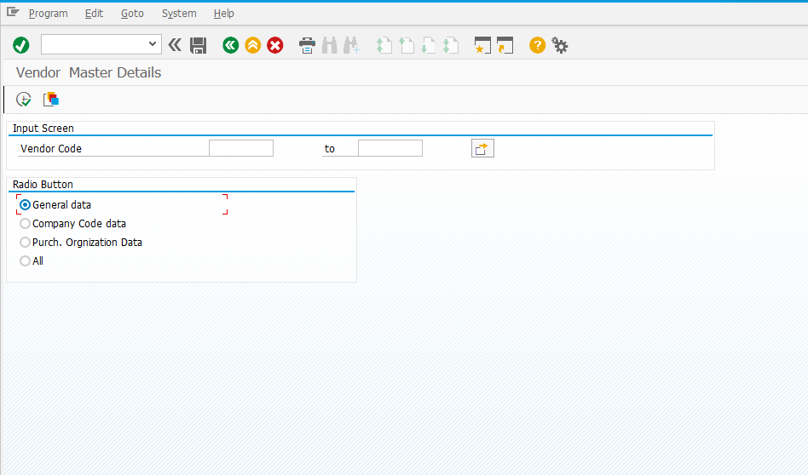
View of Report after execution

Slide 49
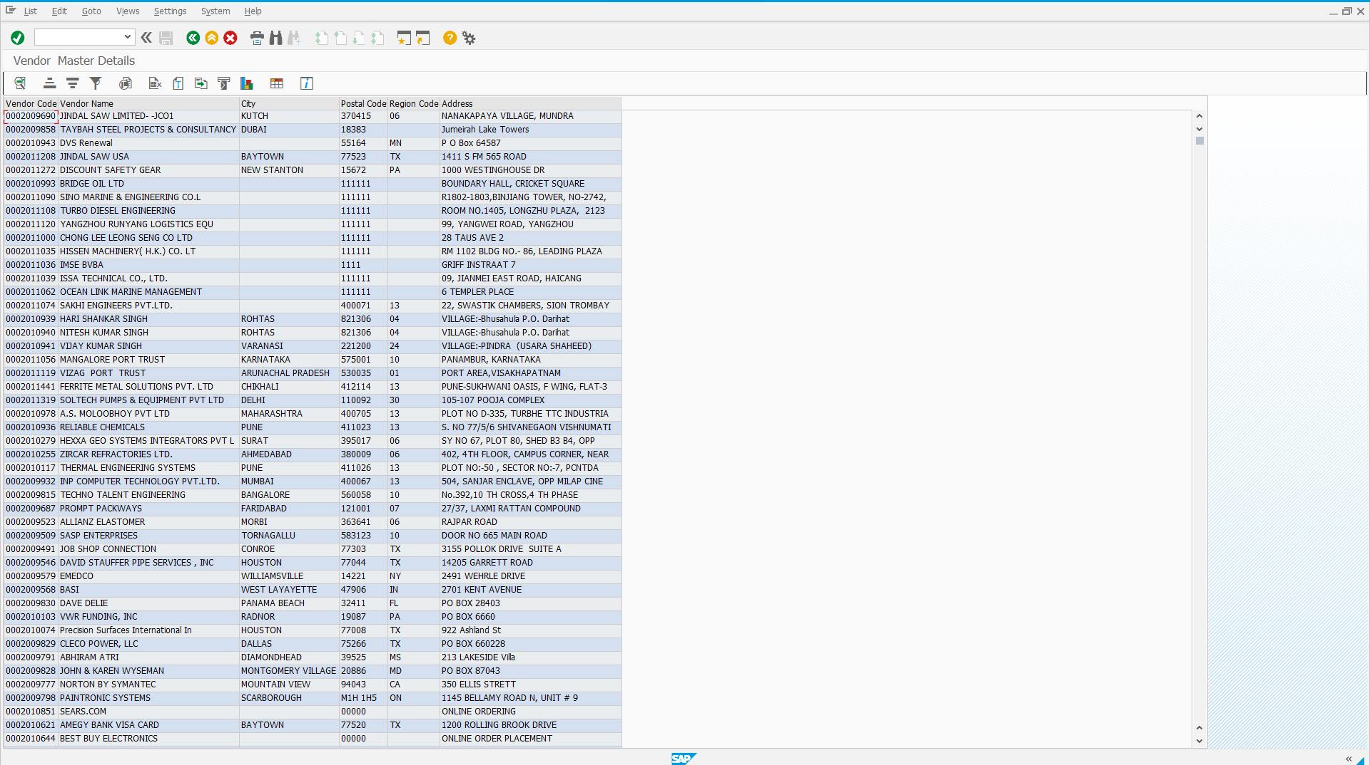
View of report after inserting vendor code

Slide 50
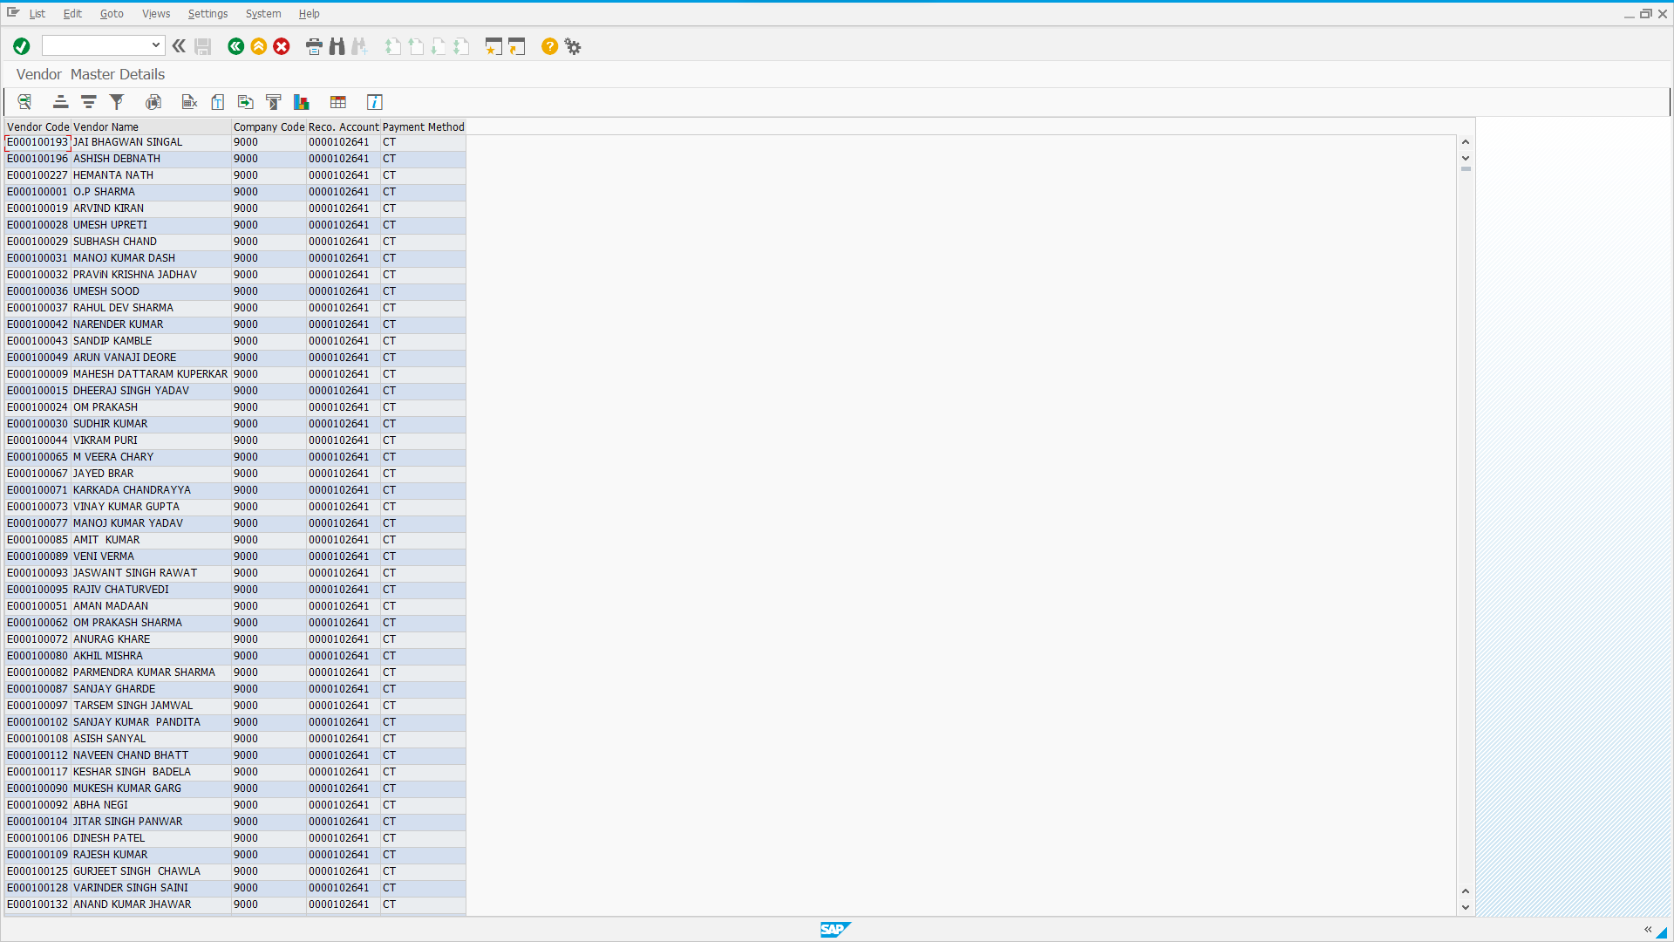
View of report after inserting company code

Slide 51
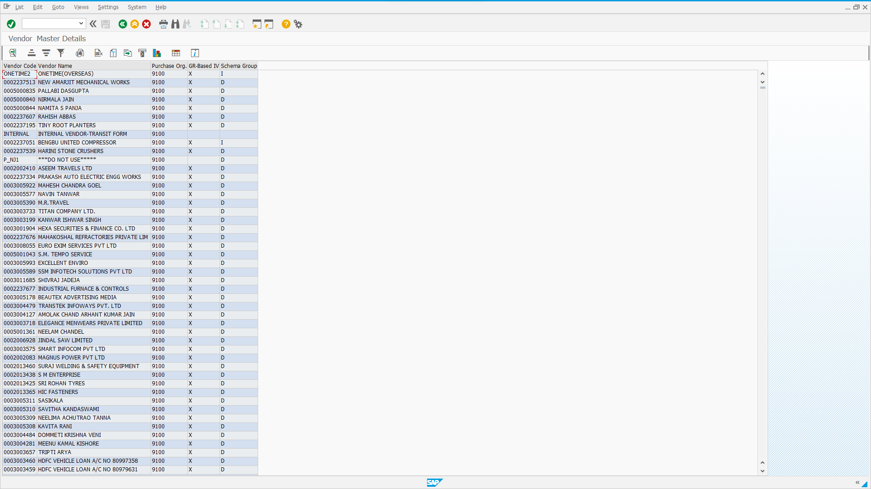
View of report after inserting purchasing organization data

Slide 52
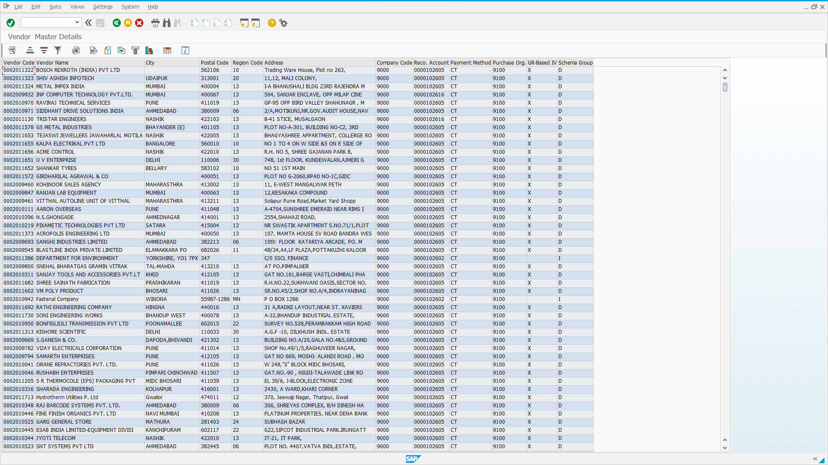
View of report after inserting all

Slide 53
Overview of the Project
ABAP (Advanced Business Application Programming), is a fourth-generation programming language, used for development and customization purposes in the SAP software. Currently positioned along with Java, as the main language for SAP application server programming, most of the programs are executed under the control of the run-time system.
Here we have learned about :-
System Landscape Directory.
SAP 3 Tier Architecture: Different SAP Layers.
ABAP Dictionary.
a. Database Table.
b. Delivery and Maintenance.
c. Fields.
d. Currency/Quantity Fields.
Technical Settings.
Table Maintenance Generator.
Tables.
Reports.
Events in Reports.

